Slide 1
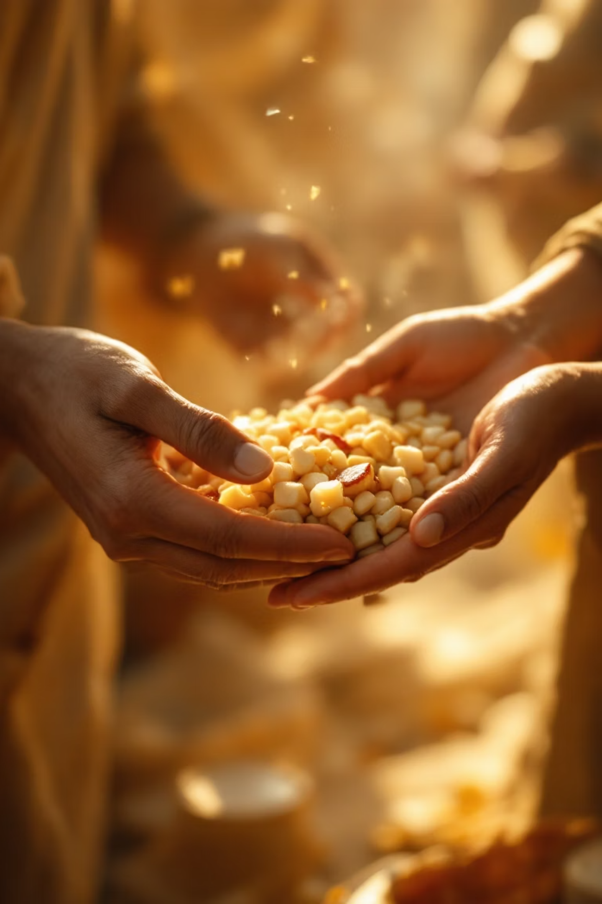
AnnDaan
Food Donation & Waste Reduction Website
Presented by
K. Niharika,
G. Harshitha,
K. Tejasree,
V. Harshitha,
T. Varshini

Slide 2
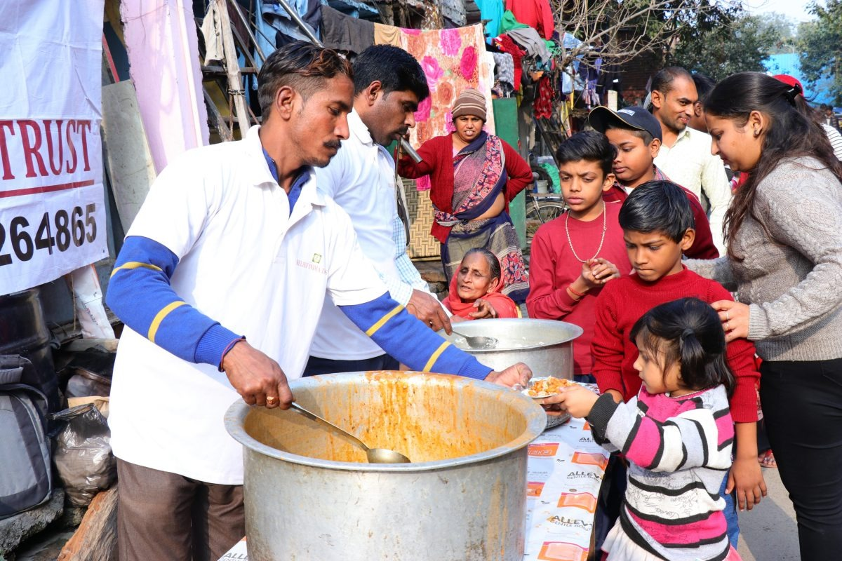
Bridging the Gap Between Surplus and Scarcity
AnnDaan is a compassionate digital platform designed to tackle one of society's most pressing challenges: food wastage. Every day, tonnes of perfectly edible food goes to waste whilst countless people struggle with hunger.
Built using Wix Vibe, our website creates a seamless connection between those who have surplus food and NGOs or individuals who desperately need it. Through a clean, intuitive interface, we're making food donation as simple as a few clicks.

Slide 3
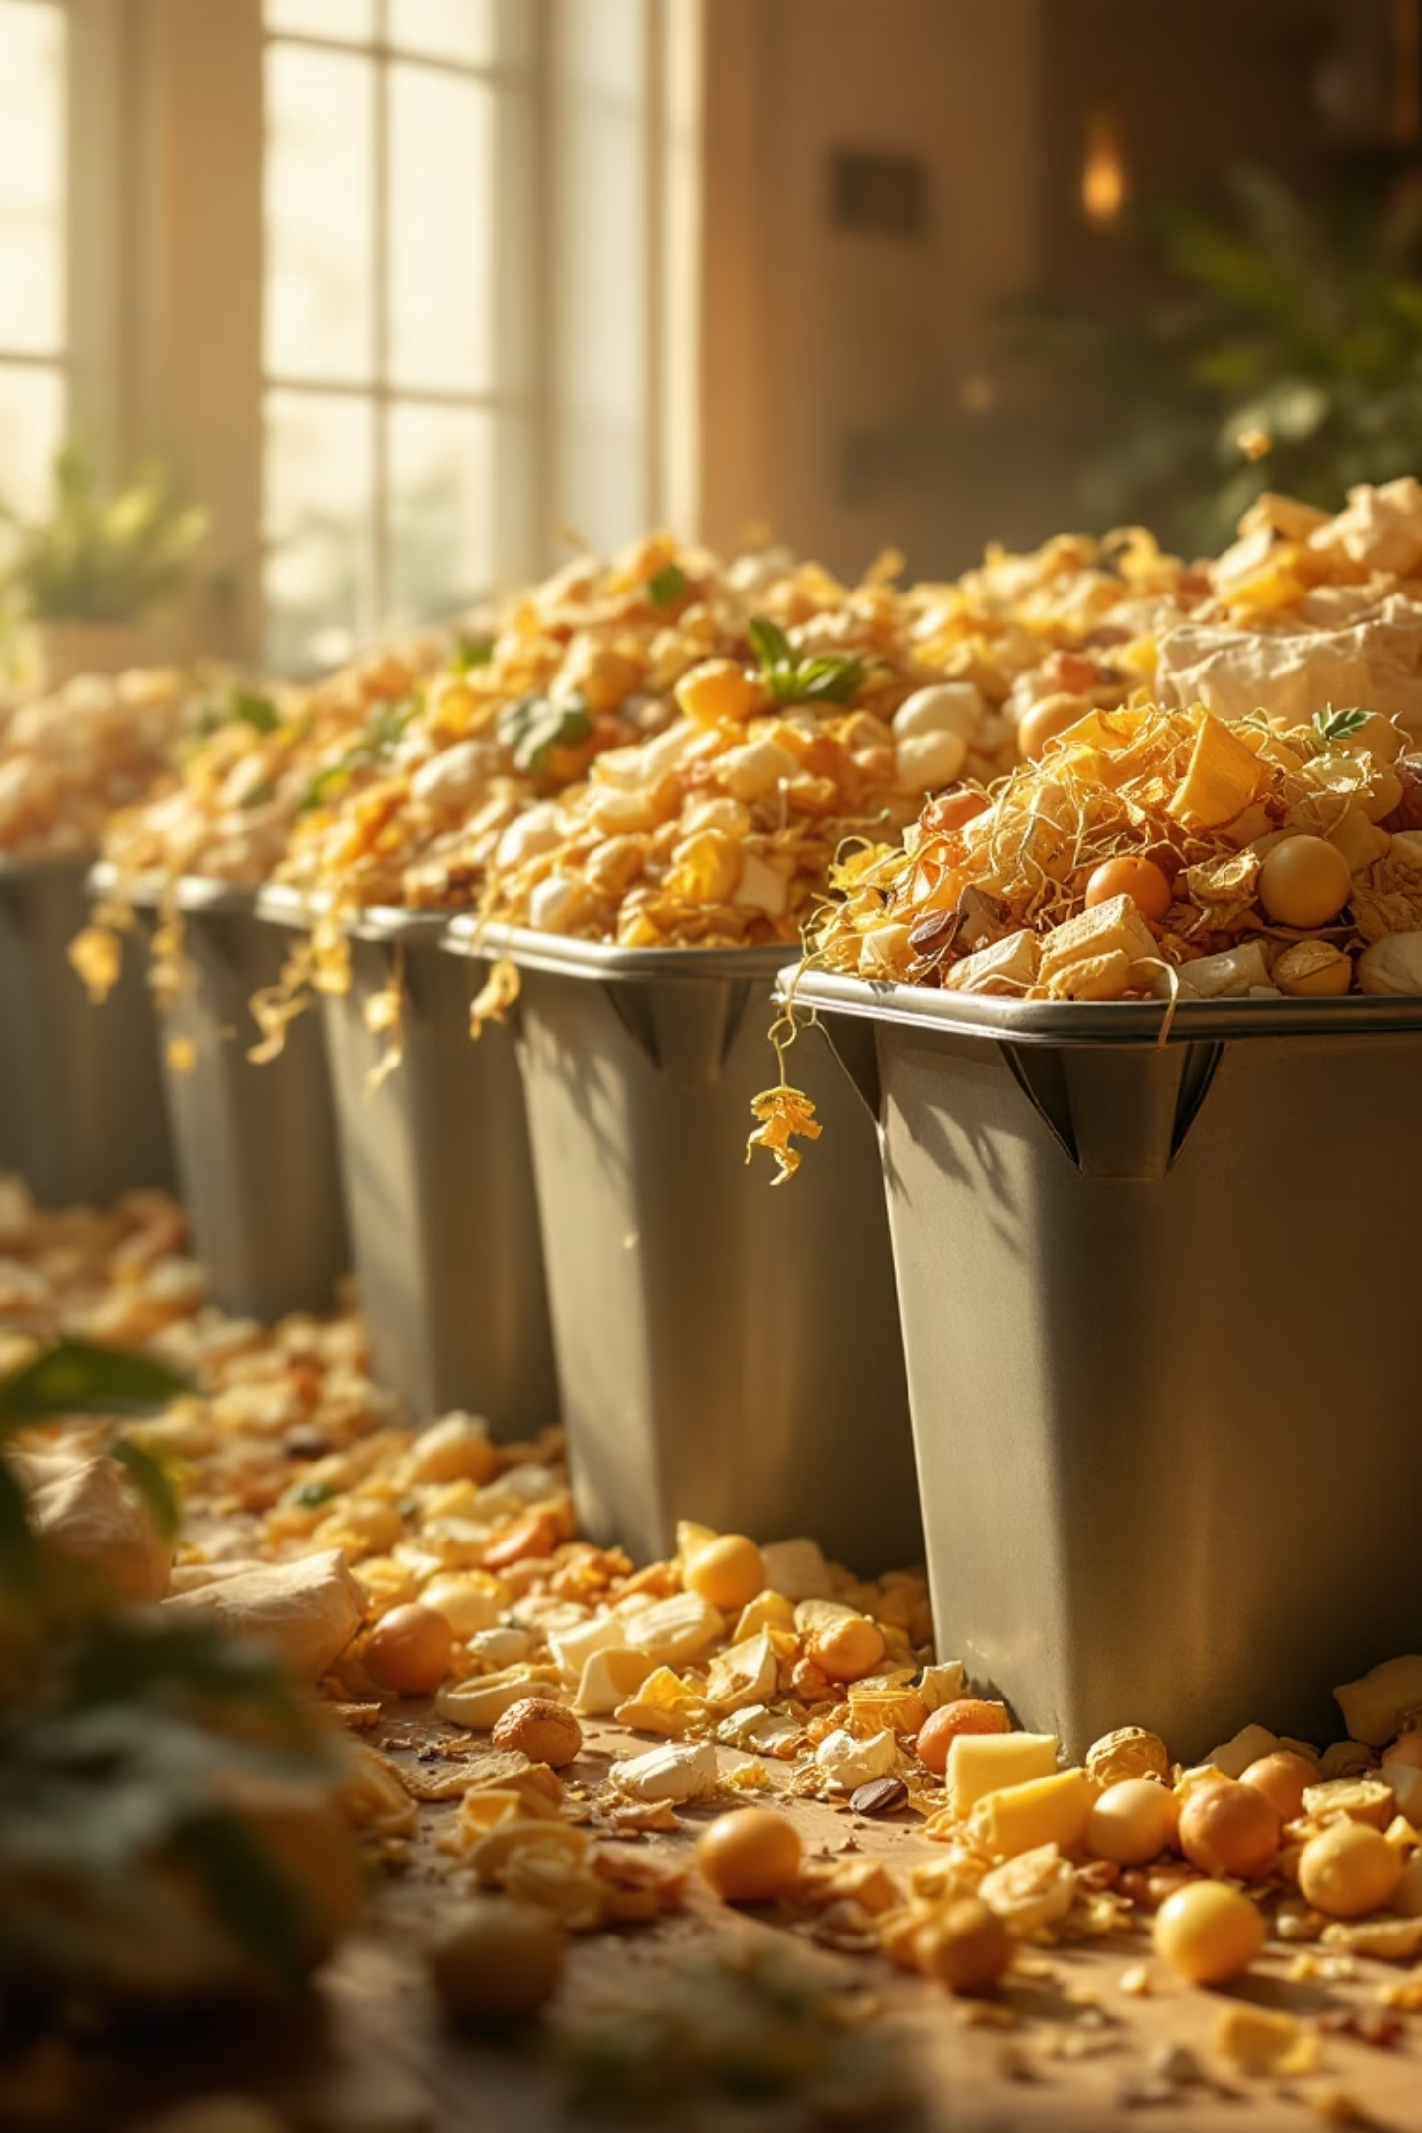
The Crisis We're Addressing
Daily Wastage
Broken Connection
Massive quantities of perfectly edible food are discarded every single day across restaurants, events, and households
No efficient system exists to quickly connect donors with those who need food urgently
Digital Gap
The absence of accessible digital platforms means surplus food ends up in rubbish bins instead of hungry stomachs
AnnDaan exists to bridge this critical gap, ensuring no meal goes to waste whilst someone goes hungry.

Slide 4
Our Mission & Vision
Simplify Donation
Eliminate Waste
Make food donation effortless and accessible to everyone—from households to restaurants to corporate events
Ensure every morsel of surplus food finds its way to someone who truly needs it, reducing environmental impact
Spread Awareness
Empower Connections
Educate communities about hunger, sustainability, and the power of collective action in fighting food insecurity
Provide a user-friendly platform that brings donors, NGOs, and volunteers together in a shared mission

Slide 5





Built with Modern Technology
Wix Vibe
AI-powered website creation for intelligent design and user experience
Wix Editor
Customisation tools to perfect every detail of the interface
Wix Hosting
Reliable deployment ensuring the platform is always accessible
Wix Forms
Interactive forms enabling smooth donor and volunteer communication
Completely no-code development — allowing us to focus on impact rather than technical complexity.

Slide 6
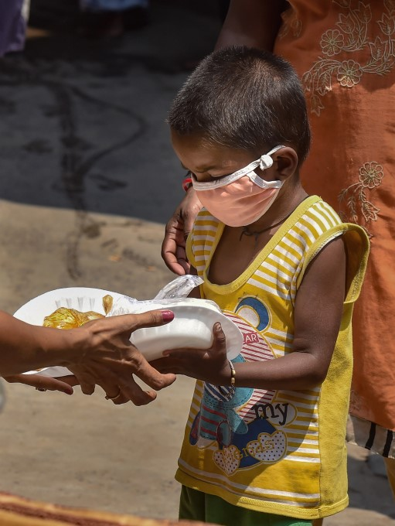
How AnnDaan Works
01
Donor Identifies Surplus
A restaurant, event organiser, or household has excess food that would otherwise be wasted
02
Connect Through Website
The donor submits details through our simple contact form, including food type, quantity, and location
03
NGO Receives Notification
Partner NGOs and registered volunteers are alerted about the available donation
04
Collection & Distribution
Food is collected promptly and distributed to those who need it most in the community
Our awareness-focused approach ensures every step is transparent and impactful, transforming potential waste into nourishment.

Slide 7




Website Structure & Navigation
Home Page
About Section
Welcoming introduction showcasing our mission and immediate impact
Deep dive into why food donation matters and the difference it makes
How It Works
Contact Section
Clear, step-by-step guide explaining the donation process
Easy access for donors to reach out and volunteers to register
Strategic call-to-action buttons guide users seamlessly through their journey, whether they're donating food or offering their time.

Slide 8

Key Features That Set Us Apart
Clean & Attractive UI
Awareness-Based Content
Thoughtfully designed interface that's both beautiful and functional
Educational material inspiring action and compassion
Fully Mobile-Responsive
Interactive Forms
Perfect experience across all devices—desktop, tablet, or smartphone
Simple submission for donors and volunteers to connect
Fast Performance
Intuitive Navigation
Lightweight architecture ensuring quick loading times
Users find what they need instantly without confusion

Slide 9

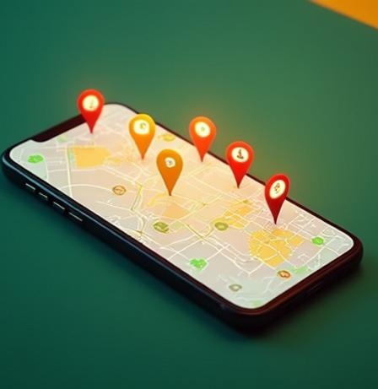

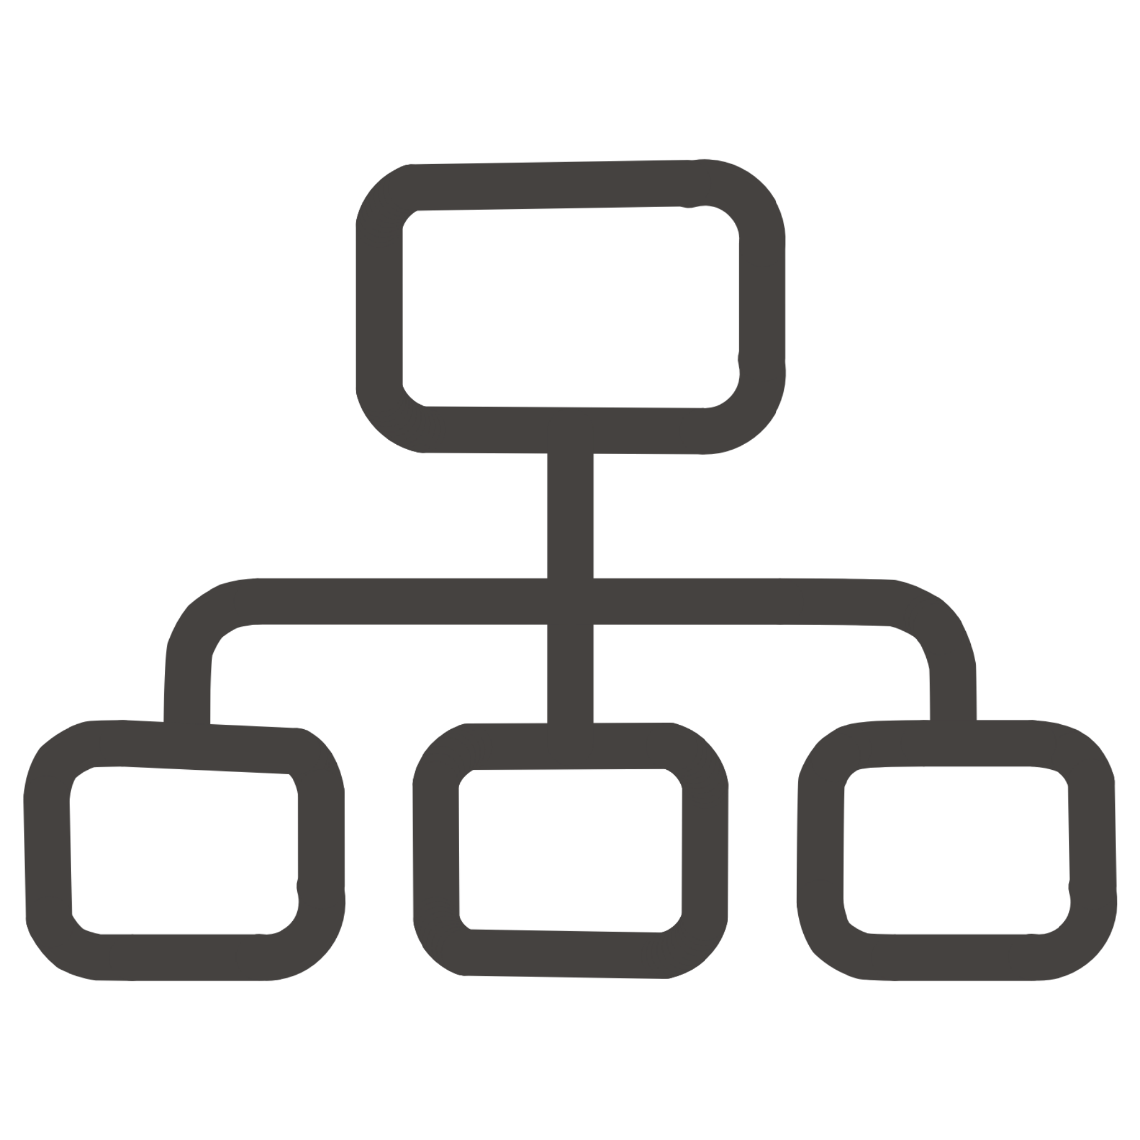



The Road Ahead: Future Enhancements
Whilst AnnDaan is already making a difference, we envision expanding its capabilities to create an even more robust ecosystem for food donation.
User Authentication System
Secure login portals for donors, NGOs, and volunteers with personalised dashboards
Live Donation Listings
Real-time feed showing available food donations with quantities and locations
Location-Based Matching
Intelligent map integration connecting nearby donors with NGOs for faster response
Instant Notifications
Push alerts ensuring NGOs never miss an opportunity to collect surplus food
Pickup Tracking
Live tracking system for transparency and coordination between all parties
Volunteer Portal
Dedicated registration and management system for individual volunteers

Slide 10

Thank You
Together, we can ensure no meal goes to waste whilst someone goes hungry. Join us in the mission of AnnDaan.
Visit us at: AnnDaan Website

